Slide 1
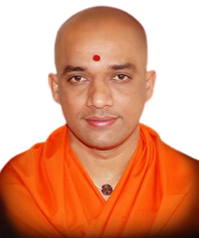
BGS Institute of Technology
|| Jai Sri Gurudev||
BG Nagara – 571448, Nagamangala Taluk, Mandya District
Department of Mechanical Engineering
Hearty Welcome
to
NBA Committee Members

Slide 2
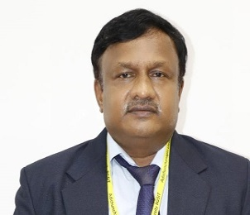
Head of the Department
Dr. Manjunath S H _{M.E, PhD ,MIE,FIE,LISC}
Professor & Head
Department of Mechanical Engineering
Education: B.E – BMSCE,BU – 1990 M.E – UVCE,BU- 1995 PhD – VTU- 2010 | Experience: Teaching Experience – 30 Years Research Experience – 15 Years
Ph.D Guiding: VTU, Belagavi – 2 ACU, BG Nagara – 1 RU, Bangalore - 02 | Research Papers: International Journal – 12 International Conference – 10 National Conference- 13
Ph.D Guided: VTU, Belagavi – 2 Nos. | Grants Received: KREDL, GOK – Rs. 1.00 Lakh -2020

Slide 3
Introduction
Programme started | 2010-11
Sanctioned Intake | 60
Students Ratio | Male : Female :: 90 : 10
Faculty Cadre Ratio | 2:2:11
Faculty Student Ratio | 1:16
Average Experience | 12 Years
Ph.D Guides and Scholars | 04 and VTU-04, ACU-07
Approved Research Centres | BGS R&D Centre
Competent and well qualified faculty members | Skilled Technical staff Adequate infrastructure ( class rooms, Internet facility, etc.)
Well equipped laboratories | Conducive environment for teaching-learning and overall development of students

Slide 4
Introduction Faculty – Infrastructure - Students
Female Faculty – 02
Male Faculty - 13
10
Laboratories
04
Higher Studies
15
Professors
4
Class Rooms
10
Entrepreneur
2
Department Library
85
Associate Professors
1
Placements
2
98.5
Avg. Pass % in last three years
Assistant Professors
1
Seminar Hall
11
1
BGS R&D Center
76.11
Enrolment Ratio (In last three years)
Ph.D Holders
4
1
Project Lab
Faculty Pursuing Ph.D
5
05
Faculty Chambers
Paper Publications
36
500 Mbps
Internet

Slide 5
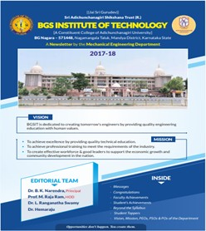
Department Achievements
Achievements | Details | Position/ Sponsorer
Center of Excellence | Artisan Training Center | MICO-BOSCH 50 lakhs
Center of Excellence | BGSIT-TOYOTA COE | TOYOTA Motors 40 Lakhs
Department PUBLICATIONS
Batch | I | II | III | IV | V | VI | VII | VIII
2016-2020 | 58.18 | 58.18 | 58.33 | 53.42 | 54 | 100 | 81 | 100
2015-2019 | 49.02 | 42.00 | 49.23 | 50.00 | 64.18 | 51.5 | 91.80 | 98.36
2014-2018 | 49.12 | 59.65 | 62.23 | 40.30 | 65.30 | 66.67 | 91.3 | 95.65
2013-2017 | 47.54 | 49.12 | 60.29 | 70.58 | 79.69 | 50.79 | 85.97 | 100

Slide 6
Faculty Achievements
Achievements | Details | Position/ Sponsorer
Sponsored Project | PI: Dr.Girisha K B 2019-20 | Amount: Rs.20 Lakhs, Duration: Two years, VGST KFIST-L1, GOK
Sponsored Project | PI: Dr.Manjunath S H 2019-20 | Amount: Rs.1.00 Lakh, Duration: One year, KREDL, GOK
Patents | 05 Patents are filed during 2019-20 | 04 Indian and 01 US
Professional Membership Bodies
Indian Science Congress Life Members -15 | ISTE Life Members - 15
IEI Life Members - 09 | Indian Society of Mechanical Engineers Life Members-11

Slide 7
Faculty Achievements
Sl. No | Name | Title of the Book/Publication | Title of the Chapter
1 | Dr. Manjunath S H Dr. Girisha K B | Springer Nature Singapore Pte. Ltd. 2021 | Numerical Analysis of Turbulent Heat Exchanger Tube Using Novel Para-Winglet Tape pp 753-766
2 | Santhosh Kumar T C | Emerging Trends in Engineering and Technology ( Volume-1) ISBN 976-93-90471-48-5 | Programming Logic Controllers(PLC’s)
Sl.No | Title of book | Name of the authors | Publications | Year of publication
1 | Operation Research | Dr.Ranganathaswamy L | Sun star | 2019
Sl. No | Academic Year | Number of Publication by Staff
01 | 2020-21 | 07
02 | 2019-20 | 11
03 | 2018-19 | 03

Slide 8
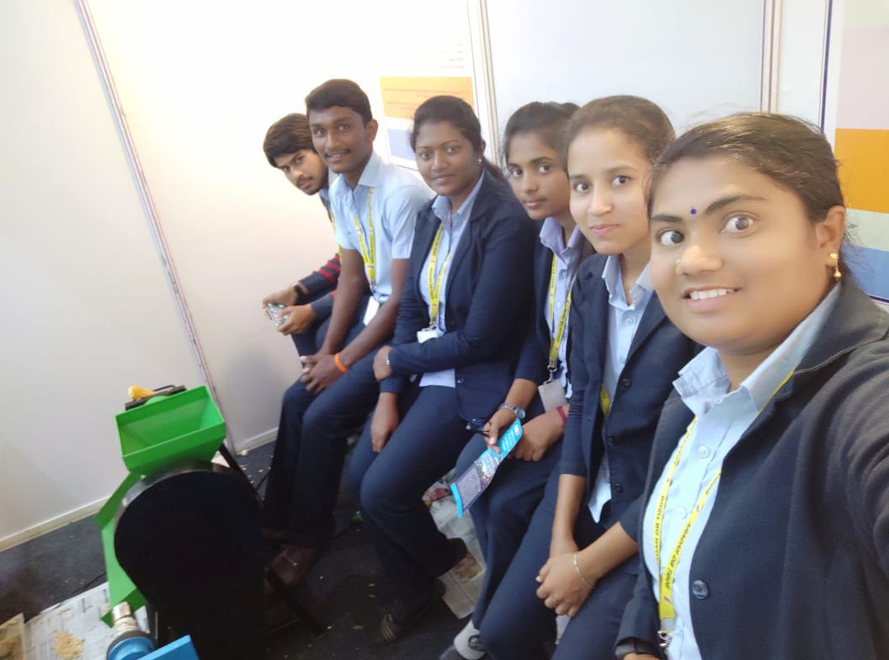
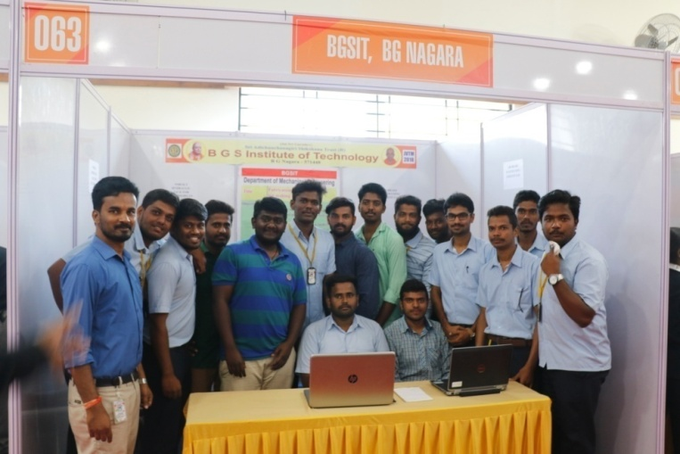
Student Achievements
Achievements | Details | Position/ Sponsorer
Sponsored Project | PI: Santhosh Kumar T C And Students | Amount: Rs.7,000.00, Duration: One years, KSCST, GOK
Projects Exhibition at JVTM

Slide 9
Criteria-1 Institute & Department Vision & Mission
 | Institute | Department
 | BGSIT is committed to the cause of creating tomorrow’s engineers by providing quality education inculcating ethical values. | Producing competent and sustainable Mechanical Engineers through Excellence, Innovations and Ethics
 | M1: Imparting quality technical education by nurturing a conducive learning environment. M2: Offering professional training to meet industry requirements. M3: Providing education with a moral - cultural base and spiritual touch. | M1: Offering quality Education by competent faculty. M2: Providing adequate infrastructure and learning ambience. M3: Developing inclination towards higher education, research, entrepreneurship and professional ethics. M4: Promoting interaction with industries.

Slide 10
Criteria-1 Department PEO’s and PSO’s
PROGRAMME EDUCATIONAL OBJECTIVES (PEOs):
PEO 1:Graduates will be pursuing successful career & higher education.
PEO 2:Graduates will be able to Design, Analyze, Fabricate & Manage Applications of Mechanical Engineering.
PEO 3: Graduates will display professional ethics to work in a team & lead the team by effectively communicating the ideas.
PEO 4:Graduates will practice lifelong learning.
PROGRAMME SPECIFIC OUTCOMES (PSOs):
PSO1: Ability to acquire competencies in Designing, Analyzing and Evaluating the Mechanical Components
PSO2: Ability to work professionally by applying Manufacturing and Management practices.

Slide 11
Criteria-1 Vision, Mission and PEO’s Publishing and Dissemination
Stakeholders | Published at | Dissemination Method
Internal Stakeholder (Management, Principal, HOD, Faculty, Students and Non-Teaching Staff) | Institute Website www.bgsit.ac.in Department news Letter Department Notice boards Classrooms Department Laboratories Department Library HOD Chamber Faculty Cabins Lab Manuals Seminar Hall | Orientation Programs Department Meetings Workshops Seminars Conferences Faculty Development Programs Training Programs e – mail
External Stakeholder (Parents, Alumni, Employers, Professional Bodies, Industry) | Institute Website www.bgsit.ac.in Department News Letters | Parent-Teachers Meetings Alumni Interactions e-mail

Slide 12
Criteria-2 Program Curriculum & Teaching Learning Process
Scheme | Year of Study | Evaluation
2010 Scheme | 2013-17 | 100 Marks (External) 25 Marks (Internal)
 | 2014-18
Choice Based Credit System (CBCS) | 2015-19 | 80 Marks (SEE) 20 Marks (CIE)
 | 2016-20
 | 2017-21 | 60 Marks (SEE) 40 Marks (CIE)
Continuous Internal Evaluation (CIE):
Test Question paper
Lab Assessment
following RUBRICS
Semester End Examination (SEE): Question paper and Valuation of answer scripts done as per the scheme prepared by the University with RUBRICS
Assessment of Technical Seminar, Internship and Project work is done as per RUBRICS

Slide 13
Criteria-2 Program Curriculum & Teaching Learning Process
Curriculum Gap Analysis and Planning, project work will be reviewed periodically
Tutorial Classes are conducted
Student Performances are monitored and analysed regularly through Proctoral System
Content Beyond Syllabus through Seminars, Flipped class, Workshops, Technical Talks, Industrial Visits, Regular aptitude and communication skill training are conducted.
Student Centric Activities are done regularly
Student Feedback System (Mid of the Semester – Offline / Online) is followed
Student Co-curricular and extra curricular activities are encouraged
MOUs with industries are executed and activities are conducted

Slide 14
Criteria-2 Program Curriculum & Teaching Learning Process
SL. No. | Method | Content Delivery | Facility
1 | Class Room teaching/student centric activities, Guest faculty | Power Point Presentation | ICT Based Content Delivery
 |  | Flipped Classes
 |  | Tutorials
 |  | QUIZ
2 | E-Learning | Video/Animations | Digital Library, Internet, You-tube, SWAYAM, MOOCS
 |  | NPTEL videos
 |  | Webinars
3 | Evaluation Assessment / Improvement | Internal assessments | Off line
 |  | Assignments
4 | Models | Using chart & Models | Charts / Models
5 | Interaction | WhatsApp Based Interaction, E-mail Interactions, Messages through Website, Other social Media Groups | ICT Based Interaction

Slide 15
Criteria-3 Program Outcomes & Course Outcomes
Course Code: 15ME54 Course Name: Design of Machine Elements-I
After the successful completion of the course, the student will be able to :
CO1: Describe the design process, choose materials..
CO2: Apply the codes and standards in design process.
CO3: Analyze the behavior of machine components under static, impact, fatigue loading
CO4: Design shafts, joints, couplings.
CO5: Design riveted and welded joints.
CO6: Design threaded fasteners and power screws.
CO | PO1 | PO2 | PO3 | PO4 | PO5 | PO6 | PO7 | PO8 | PO9 | PO10 | PO11 | PO12 | PSO1 | PSO2
15C304.1 | 3 | 2 | 1 | - | - | - | - | - | - | - | - | 1 | 3 | 2
15C304.2 | 3 | 2 | 1 | - | - | - | - | - | - | - | - | 1 | 3 | 2
15C304.3 | 3 | 3 | 3 | 2 | - | - | - | - | - | - | - | 1 | 3 | 3
15C304.4 | 3 | 3 | 3 | 2 | - | - | - | - | - | - | - | 1 | 3 | 3
15C304.5 | 3 | 3 | 3 | 2 | - | - | - | - | - | - | - | 1 | 3 | 3
15C304.6 | 3 | 3 | 3 | 2 | - | - | - | - | - | - | - | 1 | 3 | 3
AVG. | 3 | 2.66 | 2.33 | 2 |  |  |  |  |  |  |  | 1 | 3 | 2.66

Slide 16
Criteria-3 Program Outcomes & Course Outcomes
CO-PO & CO-PSO Mapping Matrix [2015-19]
 | PO1 | PO2 | PO3 | PO4 | PO5 | PO6 | PO7 | PO8 | PO9 | PO10 | PO11 | PO12 | PSO1 | PSO2
Sum of POs and PSOs | 154.6 | 117 | 84.7 | 51.7 | 46.8 | 40 | 22.25 | 28.46 | 37.11 | 34.77 | 33.12 | 49.62 | 107 | 94.83
Avg. Mapping % (Sum/186)*100 | 83.10 | 62.8 | 45.51 | 27.78 | 25.16 | 21.49 | 11.96 | 15.30 | 20.01 | 18.69 | 17.81 | 26.68 | 57.61 | 50.98
Gap Identification
From the above table it was clear that the % PO Correlation for Environment & Sustainability (PO7), Ethics (PO8), Communication (PO10) and Project Management and Finance (PO11) are respectively equal to 11.96, 15.30, 18.69, and 17.81% and can be attributed to curricular gaps. The gaps in the curriculum were well compensated by arranging various technical lectures on topics such as Environment and sustainability, professional ethics communication skills etc. Students will gain the idea to work as individual and in team by doing project work, visiting various industries and by under going internships.

Slide 17
Criteria-3 Assessment Tools for Attainment of POs & PSOs
Direct Assessment
Direct method | Assessment | Frequency of assessment
CO Attainment | 1. Test | Three IA / Semester
 | 2. Assignment | Three / Semester
 | 3. Lab Record Evaluation | Once in a week
 | 4. Lab Test Evaluation | Once in a Semester
 | 5. Seminar | Once in a Year
 | 6. Project Work | Once in a Year
 | 7. Internship | Once in a Year
 | 8. Semester End Exam | Once in a semester
Indirect Assessment
Indirect method | Assessment |  | Frequency of assessment
Program Exit Survey | Survey Questionnaire |  | End of the Programme

Slide 18
Criteria-3 Course Outcome Attainment Levels
Sl. No | Assessment Method | Max. Marks | Course Outcome
 |  |  | Levels
1 | Continuous Internal Evaluation (CIE) | 15(Test) + 5(Assignment) | For theory courses:≥70% - Level 3 >60% and <70% - Level 2 >50% and <60% - Level 1 | For assignment: ≥90% - Level 3 >80% and <90% - Level 2 >70% and <80% - Level 1
2 | Lab Internal Assessment | 20 | Lab Internal Assessment :≥80% - Level 3, >70% and <80% - Level 2 >60% and <70% - Level 1
3 | Semester End Examination (SEE) | 80 (Theory Exam) | For theory Exam : ≥70% - Level 3 ,>60% and <70% - Level 2 >50% and <60% - Level 1
 |  | 80 (Lab Exam) | For Lab Exam:≥80% - Level 3, >70% and <80% - Level 2 >60% and <70% - Level 1
4 | Project Work Phase - I Project Work (Internal) | 100 (Int) | ≥80% - Level 3, >70% and <80% - Level 2 >60% and <70% - Level 1
5 | Internship/ Professional Practice (Internal and External) | 50(Int)+50(Ext) | ≥80% - Level 3 ,>70% and <80% - Level 2 >60% and <70% - Level 1
6 | Seminar | 100 | ≥80% - Level 3, >70% and <80% - Level 2 >60% and <70% - Level 1

Slide 19
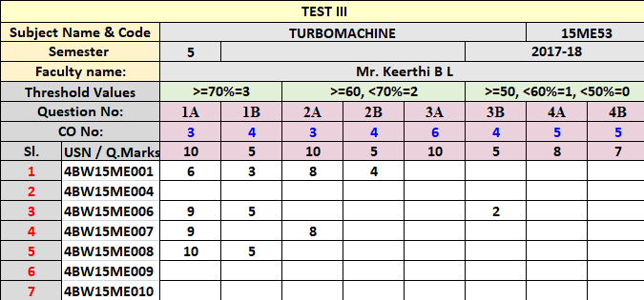
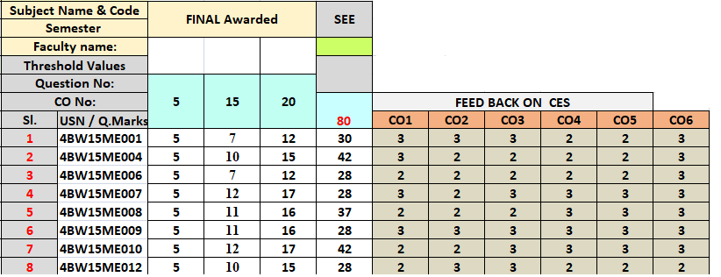
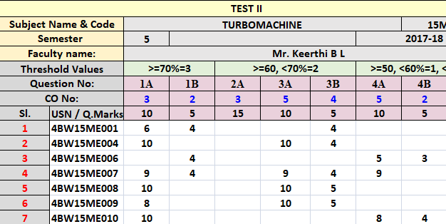
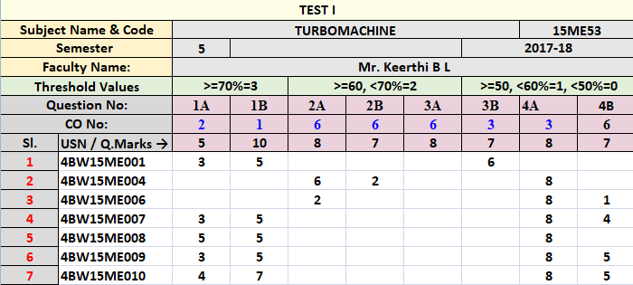
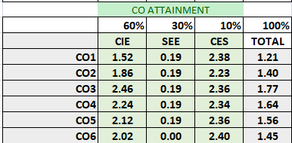
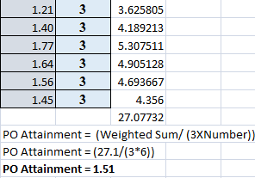
Criteria-3 CO & PO Attainment

Slide 20
Criteria-3 CO PO and PSO Attainment
Course | PO1 | PO2 | PO3 | PO4 | PO5 | PO6 | PO7 | PO8 | PO9 | PO10 | PO11 | PO12 | PSO1 | PSO2
Direct Attainment | 1.73 | 1.44 | 1.16 | 1.28 | 1.27 | 1.14 | 1.06 | 1.32 | 1.25 | 1.37 | 1.22 | 0.92 | 1.42 | 1.42
Indirect Attainment | 2.34 | 2.42 | 2.35 | 1.98 | 2.38 | 2.32 | 2.38 | 2.38 | 1.97 | 2.36 | 2.19 | 2.43 | 2.33 | 2.29
CO Attainment | 1.85 | 1.63 | 1.40 | 1.42 | 1.49 | 1.37 | 1.32 | 1.53 | 1.39 | 1.57 | 1.42 | 1.22 | 1.60 | 1.59
Batch | PO1 | PO2 | PO3 | PO4 | PO5 | PO6 | PO7 | PO8 | PO9 | PO10 | PO11 | PO12 | PSO1 | PSO2
Target | 1.8 | 1.8 | 1.8 | 1.5 | 1.8 | 1.7 | 1.7 | 1.8 | 1.5 | 1.8 | 1.7 | 1.9 | 1.8 | 1.7
2014-18 Attained | 1.77 | 1.60 | 1.40 | 1.41 | 1.53 | 1.38 | 1.29 | 1.36 | 1.27 | 1.39 | 1.49 | 1.35 | 1.59 | 1.41
Target | 1.99 | 1.73 | 1.47 | 1.48 | 1.44 | 1.33 | 1.19 | 1.42 | 1.41 | 1.46 | 1.39 | 1.04 | 1.61 | 1.55
2015-19 Attained | 1.85 | 1.63 | 1.40 | 1.42 | 1.49 | 1.37 | 1.32 | 1.53 | 1.39 | 1.57 | 1.42 | 1.22 | 1.60 | 1.59
Target | 1.99 | 1.73 | 1.47 | 1.48 | 1.44 | 1.33 | 1.19 | 1.42 | 1.41 | 1.46 | 1.39 | 1.04 | 1.61 | 1.55
2016-20 Attained | 1.86 | 1.64 | 1.48 | 1.50 | 1.42 | 1.47 | 1.39 | 1.57 | 1.47 | 1.56 | 1.48 | 1.20 | 1.60 | 1.58

Slide 21
Criteria-4 Students’ Performance
Students admitted to the program
Item | CAY 2020-21 | CAY m1 2019-20 | CAYm2 2018-19 | CAYm32017-18 | CAY m4 2016-17
Sanctioned intake of program (N) | 60 | 60 | 60 | 60 | 60
Total number of students admitted in the first year minus number of students migrated to other programs / institutions plus number of students migrated to this program (N1) | 12 | 34 | 47 | 55 | 49
Number of students admitted in the 2nd year via lateral entry (N2) | 10 | 15 | 19 | 25 | 17
Separate division of students if applicable (N3) | 0 | 0 | 0 | 3 | 3
Total Number of students admitted in the program (N1+N2+N3) | 22 | 49 | 66 | 83 | 69

Slide 22
Students admitted to the Program

Slide 23
Student Faculty Ratio (SFR)
Description | CAY(2020-2021) | CAYm1(2019-20) | CAYm2 (2018-19)
Total No. of Students in the Department (UG+PG) (S) | 223 | 238 | 241
No. of Faculty in the Department(F) | 12 (F1) | 13 (F2) | 11 (F3)
Student Faculty Ratio(SFR) | SFR1=S1/F1 = 18.58 | SFR2=S2/F2 = 18.31 | SFR3=S3/F3 = 21.91
Average SFR | SFR=(SFR1+SFR2+SFR3)/3 = 19.6
F=Total Number of Faculty Members in the Department (excluding first year faculty)

Slide 24
Successfully Graduated Students with and without backlogs
Year of entry | N1+N2+N3 (As defined above) | Number of students who have successfully graduated(Students with and without backlog in stipulated period of study)
 |  | I Year | II Year | III Year | IV Year
CAY (2020-21) | 12+10+00=22
CAYm1 (2019-20) | 34+15+00=49 | 34
CAYm2 (2018-19) | 47+19+00=66 | 45 | 58
CAYm3 (2017-18) | 55+25+03=83 | 49 | 65 | 64 | 64
CAYm4 (2016-17) (LYG) | 49+17+03=69 | 50 | 61 | 51 | 46
CAYm5 (LYGm1) (2015-16) | 55+18+03=76 | 54 | 62 | 47 | 44
CAYm6 (LYGm2) (2014-15) | 58+23+03=84 | 46 | 60 | 59 | 48
CAYm7 (LYGm3) (2013-14) | 57+15+03=75 | 57 | 70 | 57 | 49

Slide 25
Placement, Higher studies and Entrepreneurship
Item | CAYm1 2019-20 | CAYm2 2018-19 | CAYm3 2017-18
Total No. of Final Year Students (N) | 46 | 47 | 59
No. of Students placed in companies or Government Sector (x) | 21 | 23 | 27
No. of students admitted to higher studies with valid qualifying score (GATE or equivalent state or National level Tests, GRE, GMAT etc.) (y) | 02 | 00 | 02
No. of students turned entrepreneur in engineering/technology (z) | 08 | 01 | 01
x + y + z = | 31 | 24 | 30
Placement Index: (x + y + z) / N | 0.67 | 0.51 | 0.51
Average placement = (P1 + P2 +P3) / 3 | 0.56

Slide 26
Criteria-5 Faculty information and contribution
Sl.No | Name of the Faculty | Qualification | Designation | Date of Joining
1 | Dr. Manjunath S. H | M.E, PhD | Professor & Head | 01.07.19
2 | Dr.Girisha K. B | M.Tech,PhD | Professor | 30.08.19
3 | Dr. RanganathaSwamy L | M.Tech,PhD | Associate Professor | 17.08.05
4 | Dr. Hemaraju | M.E, PhD | Associate Professor | 15.06.11
5 | K.S. Sudeep Kumar | M.Tech | Assistant Professor | 25.01.12
6 | B.L Keerthi | M.Tech | Assistant Professor | 17.07.12
7 | H. S. Mahendra | M.Tech | Assistant Professor | 09.08.12
8 | T.C. Santhoshkumar | M.Tech | Assistant Professor | 22.07.13
9 | Mrs. H.V. Ramyarani | M.Tech | Assistant Professor | 22.07.13
10 | Pradeep. H | M.Tech | Assistant Professor | 09.06.14
11 | Mrs. Nishchitha. K.M | M.Tech | Assistant Professor | 23.07.14
12 | Sharath. N | M.Tech | Assistant Professor | 01.08.18
13 | Hemanth. C | M.Tech | Assistant Professor | 01.08.18
14 | Krupesh. K. S | M.Tech | Assistant Professor | 01.08.18
15 | Naveen. S. S | M.Tech | Assistant Professor | 01.08.18

Slide 27
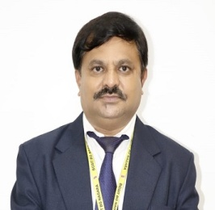
Dr. Girisha K B _{M.E., Ph.D}
Professor
Department of Mechanical Engineering
Education: B.E – BIT,BU – 1992 M.E – MSRIT, VTU- 2001 PhD – BU- 2016 | Experience: Teaching Experience – 25 Years Research Experience – 10 Years
Ph.D Guiding: VTU, Belagavi – 3 ACU, BG Nagara – 2 | Research Papers: International Journal – 14 International Conference – 06 National Conference- 08
Grants Received: VGST - K-FIST L1 – Rs. 20.00 Lakhs -2019

Slide 28
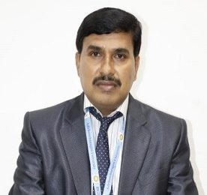
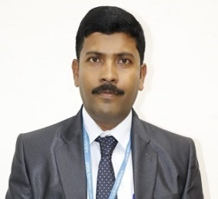
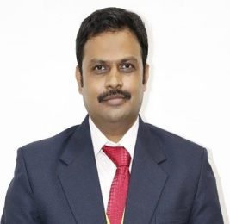
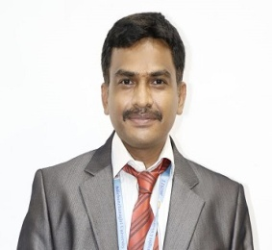
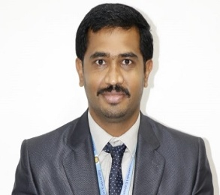
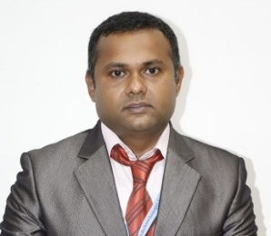
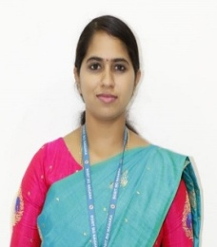
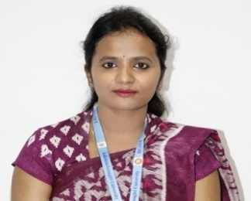
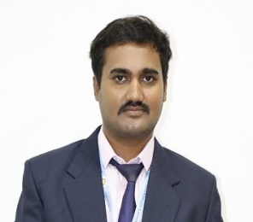
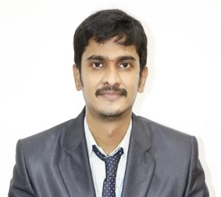
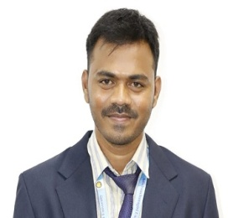
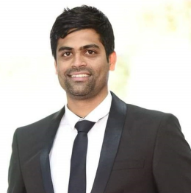
Dr. S H MANJUNATH
Dr. GIRISH K B
Dr. RANGANATHA SWAMY L
Dr. HEMARAJU
Prof. SUDEEP KUMAR
Prof. SANTOSH KUMAR T C
Prof. MAHENDRA H S
Prof. KEERTHI B L
Prof. PRADEEP H
Prof. RAMYARANI H V
Prof. NISCHITHA K M
Prof. SHARATH N
Prof. HEMANTHA C
Prof. NAVEEN S S
Prof. KRUPESH K S

Slide 29
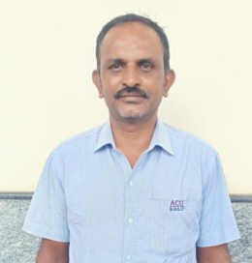
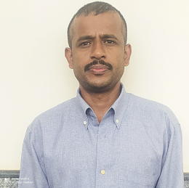
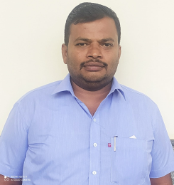
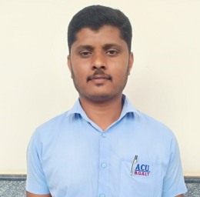
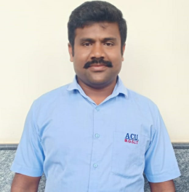
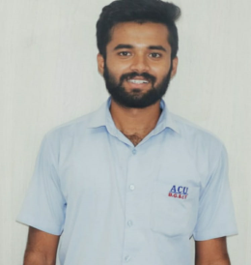
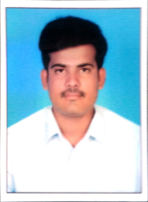
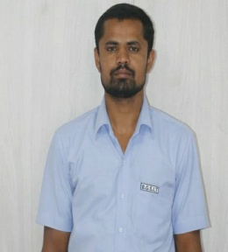
Technical/Supporting Staff
1 | Vishwanath G M | ITI(Diploma) | Assistant Instructor
2 | Shashidhar S K | Diploma | Assistant Instructor
3 | Prabhu J S | ITI(Diploma) | Assistant Instructor
4 | Manjunath A S | ITI | Assistant Instructor
5 | Shivashankara K | ITI(Diploma) | Assistant Instructor
6 | Manjunath S J | ITI | Assistant Instructor
7 | Jeevan M | Diploma | Assistant Instructor
8 | Prashantha D G | SSLC | Attender
Vishwanath G M
Shashidhar S K
Prabhu J S
Manjunath A S
Shivashankara K
Manjunath S J
Jeevan M
Prashantha D G

Slide 30
Faculty Details Year Wise
 | 2020-21 | 2019-20 | 2018-19 | 2017-18
No. of Faculty | 15 | 16 | 14 | 13
No. of Professors | 02 | 02 | 00 | 00
No. of Assoc. Professors | 02 | 02 | 02 | 01
No. of Assistant Professors | 11 | 12 | 12 | 12
No. of Ph.D. holders | 04 | 04 | 02 | 01
Faculty Pursuing Ph.D. | 05 | 05 | 05 | 03
Research & Development
Supervisors | Registered | Completed
04 | VTU-04 ACU-07 | VTU-02
Sl.No | Particular | No.
1 | Reputed Journals (Scopus Indexed, etc.,) | 24
2 | Other Journals (IRJET, JAERD,IRJMET & IRJEMET etc.,) | 35
3 | Conference | 27

Slide 31
Criteria-6 Facilities and Technical Support
Sl. No. | Description | No.
1. | Class Rooms | 04
2. | Board Room | 01
3. | Seminar hall | 01
4. | HoD Room | 01
5. | Professor Rooms | 03
6. | Faculty Rooms | 05
7. | Department library | 01
8. | COE | 02
9 | Visitors Lounge | 01
10 | Rest Rooms | 06
Sl. No. | Laboratory | Space (Sq. mts.)
1. | CAED/CAMD & CIM/CAMA LAB | 187
2. | Design Lab | 124
3. | Heat Transfer Lab | 124
4. | MMM Lab | 124
5. | Material Testing Lab | 124
6. | Fluid Mechanics & Machinery Lab | 160
7. | Energy Conversion Lab | 129
8. | Foundry & Forging Lab | 129
9. | Machine Shop | 160
10. | Project Lab | 133
11. | Research & Development | 62
12 | Seminar Hall | 184

Slide 32
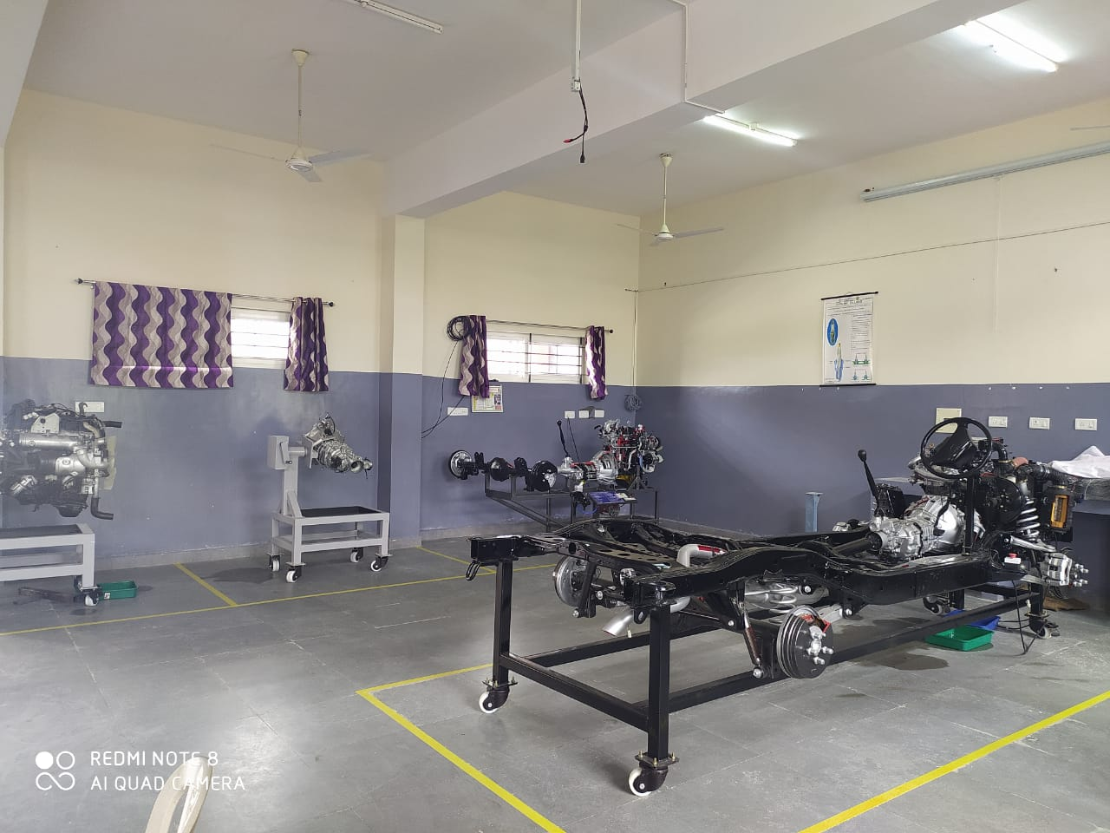
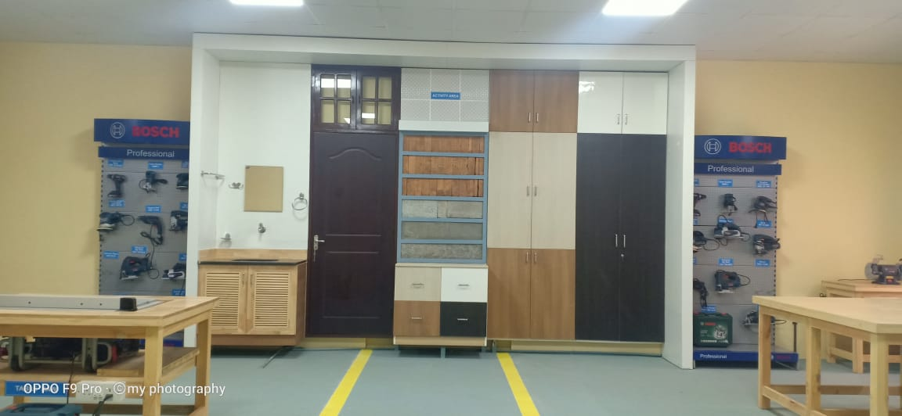
Criteria-6 Facilities –Special Labs
BGSIT –Toyota COE
Artisan Training Center- MICO-BOSCH
Department Corridors, Classrooms, Seminar Hall, Staff Rooms are covered with CCTV surveillance.
All the Laboratories are equipped with First Aid Kits.
Fire Extinguishers are placed at the relevant places in the corridors.
All Laboratories are displayed with Do’s & Don’ts safety boards.

Slide 33
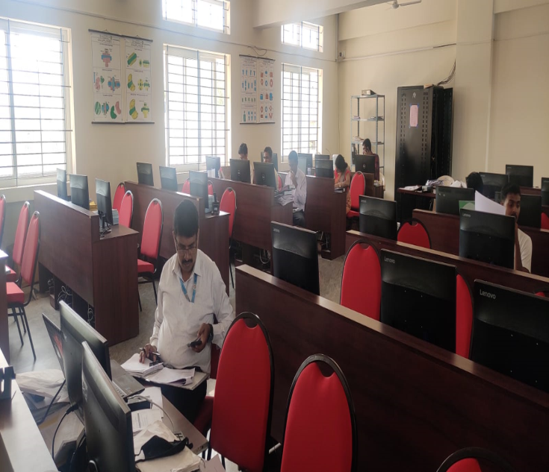
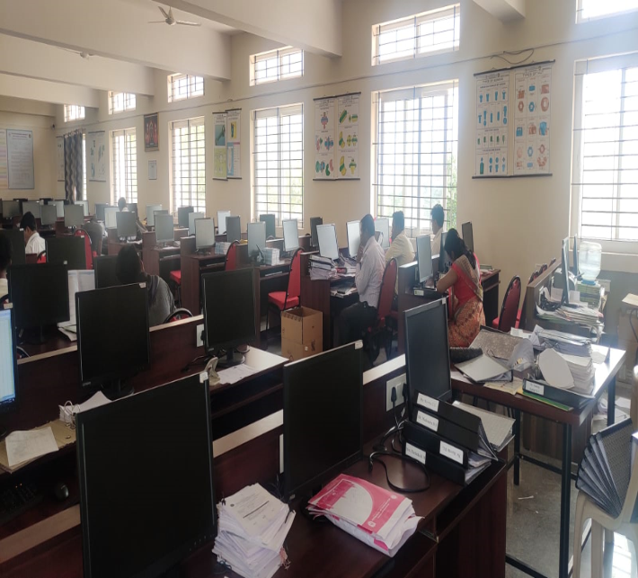
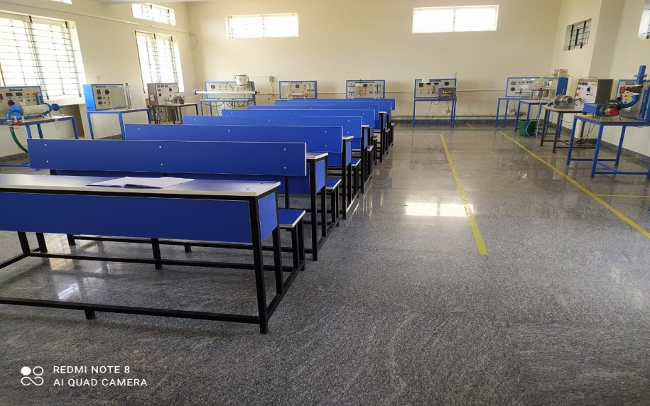
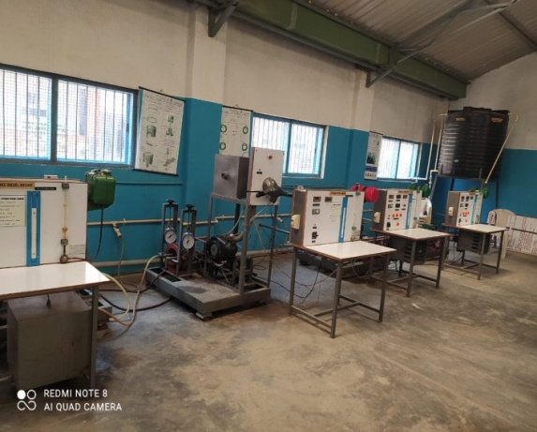
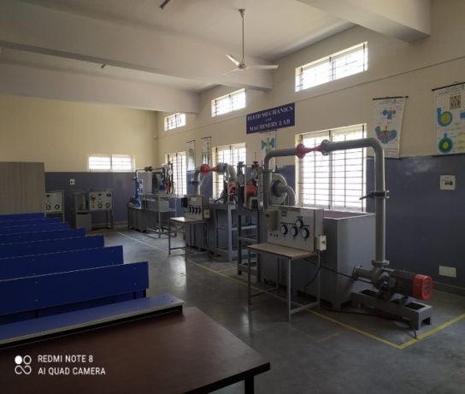
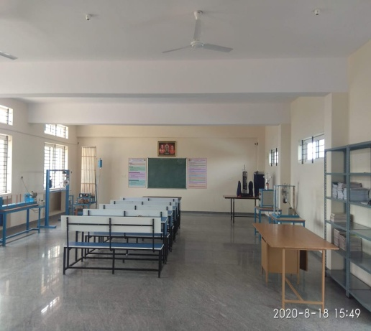
Criteria-6 Facilities and Technical Support
CAED/CAMD Lab
CAMA/CIM Lab
Heat Transfer Lab
Energy Conversion Lab Fluid Machinery Design lab

Slide 34
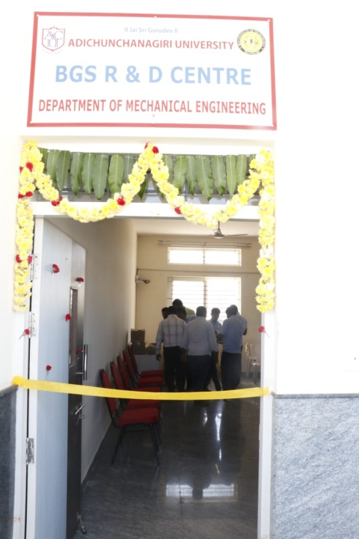
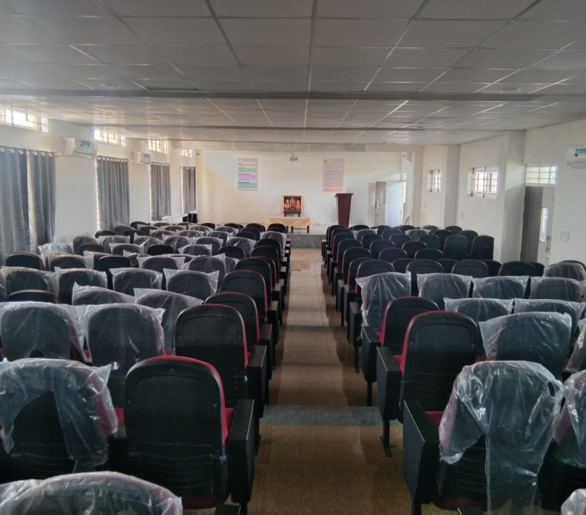
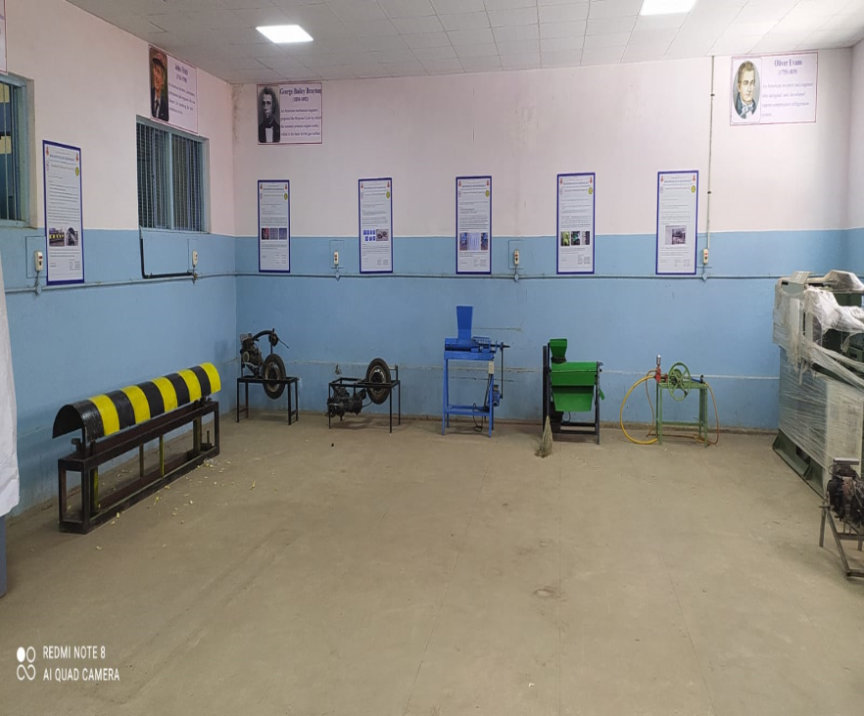
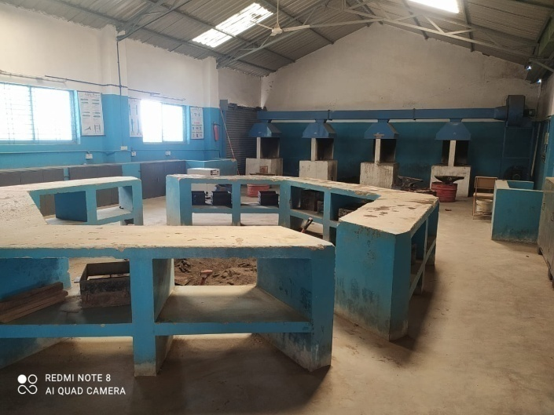
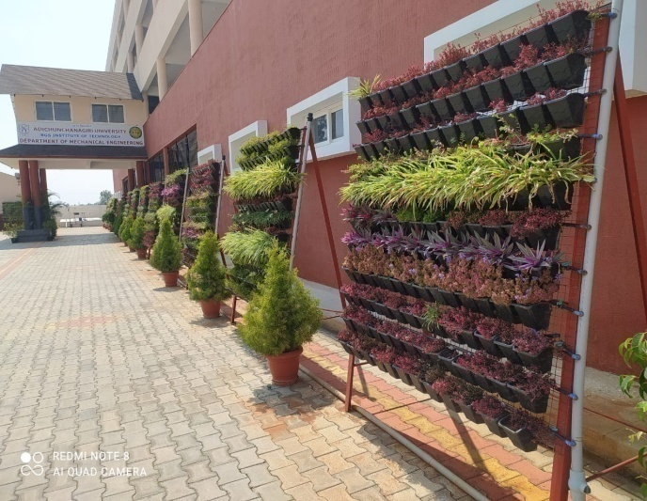
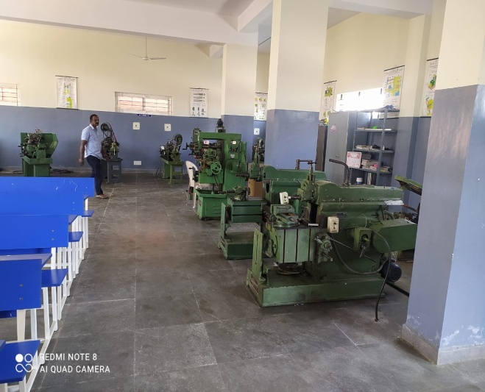
Criteria-6 Facilities and Technical Support
Research laboratory
Seminar Hall 200 seating
Project laboratory
Foundry and Forging Lab Vertical Garden Machine shop

Slide 35
Criteria-6 Facilities and Technical Support
Legal Software's
Solid Edge V21( 60 User Licenses)
ANSYS V20 (25 users)
CADEM (25 users)
Department Library
A Departmental Library has been setup under the supervision of a Department staff in order to help the students.
The Department Library has a collection of :
Books donated by Alumni and staff members
Project reports
Technical Seminar reports
These are available to students for reference
No. of Books available : 1400
BEYOND CURRICULAM
3D Printing
Injection Molding Machine

Slide 36
Criteria-6 Project Lab & Research Lab
Sl.No | Facilities | Utilization by Students, Research scholars and Faculty members
1 | Solid Edge Version 20 | Drafting and Modeling
2 | ANSYS Version 2021 | Modeling , Design and Analysis
3 | CADEM Version 16 | To simulate the manufacturing process for Turning and Milling
4 | Welding Machine (Primary Voltage: 220- 440, Secondary Voltage: 50/80, Frequency Cycles: 50, Phase: 3.) | Fabrication work
5 | Drilling Machine (Universal, Radial, 25 mm Cap, 3 Phase (1 HP and 0.5 HP) Motors, Belts) | Fabrication work
6 | Melting Furnace (1000 o C, Capacity: 5 kgs) | Metal melting for Casting
Name of the equipment | Specification
Muffle furnace | 12 X 6 X 6 inches Capacity of 5Kg at a temperature of 11000ºc
Melting furnace | Capacity of 5Kg at a temperature of 10000c
Stir casting setup | Speed 300rpm
Metal dies | 200mm X 12mm
Computerized Pin on disc Wear Testing Machine | Load 200 N, Speed: 0.26- 10m/s, Wear dia: 165 X 8 mm Pin dia: 3 to 12 mm.

Slide 37
Criteria-7 Continuous Improvement
POs & PSOs Attainment Levels and Actions for Improvement

Slide 38
Criteria-7 Continuous Improvement In the quality of students admitted to the program through KCET

Slide 39
Criteria-7 Continuous Improvement In the quality of students admitted to the program through DCET

Slide 40
Improvements in Results
 | 2018-19 | 2019-20
1st Sem | 42.10 | 46.29
2nd Sem | 58.92 | 42.00
3rd Sem | 33.33 | 54.23
4th Sem | 39.68 | 55.93
5th Sem | 64.45 | 69.69
6th Sem | 66.67 | 51.51
7th Sem | 91.30 | 90.16
8th Sem | 95.65 | 100
Year of Admission | Average % Marks of PCM
2020-2021 | 67
2019-2020 | 62
2018-2019 | 63
2017-2018 | 62
2016-2017 | 65

Slide 41
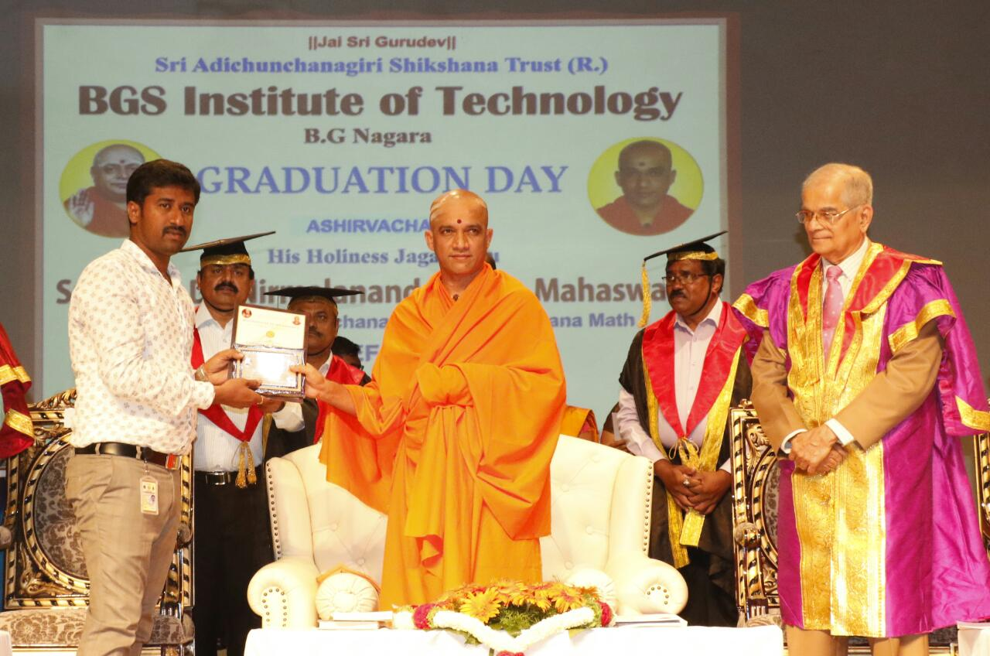
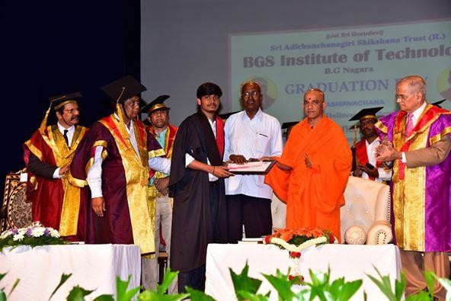
RECOGNITIONS
Achievements | Name | Details
Best Faculty Award-2019 | Mr. Mahendra H S Mr. Keerthi B L | BGS Institute of Technology
Best Outgoing Student Award-2019 | Mr. Chethan S Birder | Prof. M Raja Ram Memorial award
Best Faculty award to Mr.Mahendra H S Prof. M Raja Ram Memorial award

Slide 42
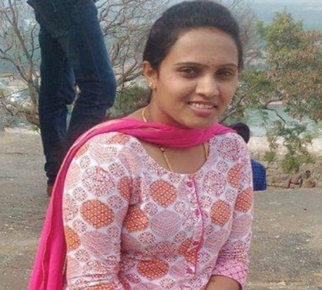
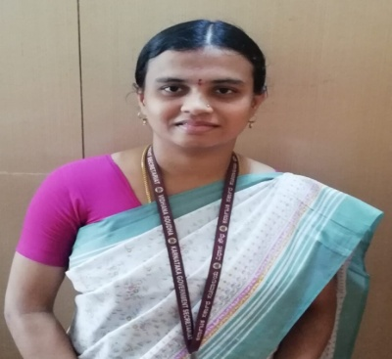
Alumni Achievements
Champa B M
Karnataka Power Corporation Limited
Namitha H R
Karnataka Government Secretariat
Manasa D
KSRTC
Thejgopal S
Karnataka State Police
Hemanth D
Government of Karnataka
Kastura K
Indian Railways
Nagendra K M
Indian Railways

Slide 43
key Initiatives
Tree Planting in the Campus
Motivational activities by HOD and Faculty
IC Engine Model Demonstration
Industrial Visit: KPCL, Shivanasamudra Workshop on 3D Printing

Slide 44
Outcome Based Education(OBE) Framework for Outcome Based Education
Institute Vision and Mission
Program Outcomes
Washington Accord
Teaching Learning & Evaluation
Department Vision and Mission
Course Outcomes
Program
Program Educational Objectives
Graduate Engineer

Slide 45
Outcome Based Education(OBE)
Outcomes based education (OBE) is a process that involves the restructuring of curriculum, assessment and reporting practices in education to reflect the achievement of high order learning and mastery rather than the accumulation of course credits
Benefits of OBE:
More directed & coherent curriculum.
Graduates will be more “relevant” to industry & other stakeholders (more well rounded graduates)
Continuous Quality Improvement (CQI) is in place.

Slide 46
Outcome Based Education(OBE)
Approach of OBE
Identifying Desired Outcomes
Determining assessment measures for the achievements of Outcomes
Deciding on strategies and methodologies to achieve those outcomes

Slide 47
Accreditation

Slide 48
Graduate Attributes

Slide 49
Outcome Based Education

Slide 50
OBE Framework

Slide 51
Bloom’s Taxonomy

Slide 52
Outcome Based Education(OBE)
Students Under OBE
Students are expected to be able to do more challenging tasks other than memorize and reproduce what was taught.
Students should be able to: write project proposals, complete projects, analyze case studies, give case presentations, show their abilities to think, question, research, and make decisions based on the findings.
Be more Creative, able to analyze and Synthesize information.
Able to plan and organize tasks, able to work in team as a community to propose solutions to problems and market their solutions

Slide 53
Outcome Based Education(OBE)
Administration System for Implementation of OBE
Course Co-ordinator
Module Coordinator
Programme Coordinator
Programme Assessment Committee
Department Advisory Board
Internal Quality Assurance Cell (IQAC)

Slide 54
Process for defining Vision and Mission statements
Institution
Vision and Mission Statements
Benchmarking Standards
SWOT Analysis
Inputs from HOD and Faculties
Formulation of Department
Draft V&M Statements
Stakeholders Inputs
PAC reviews the Department draft of V&M Statements presented by program coordinator
Not Approved
(Incorporate Suggestion)
V&M Approval by DAB
Approved
Sent to approval, by
Head of the Institution
Publishing, Dissemination and Awareness of Department Vision and Mission statements to all the Stakeholders

Slide 55
Process for defining
Program Educational Objectives (PEOs)
V&M of the Institution
Draft of Program Educational Objectives (PEOs)
Program Outcomes
V&M of the Department
SWOT Analysis
Stakeholders Input
Review and Refining of PEOs by PAC presented by Program Coordinator
PEOs Approval by DAB
Not Approved
(Redefine PEOs)
Approved
Finalize PEOs
Approval by
Head of the Institution
Publishing, Dissemination and Awareness of PEOs
to all the stake holders.

Slide 56
Essence of Closed Loop Process in OBE

Slide 57
CURRICULAR GAP IDENTIFICATION
Course Allotment
NBA
Course Allotted faculty describe the course outcome
Program Outcome
CO-PO and CO-PSO Mapping done by the course coordinator & average is calculated
Program Specific Outcome approved by DAB committee
NO
If approved by the Reviewer & HOD
YES
Consolidate the CO-PO/PSO mapping for all courses
Calculate sum of CO-PO / PSO mapping (S)
Total number of courses addressing each PO/PSO (T)
NO
% of PO’s / PSO’s Correlation >= 20
[G = (S / T) * 100]
Gap exists
YES
Action Taken
No Gap

Slide 58
Teaching-Learning Processes

Slide 59
Adherence to Academic Calendar

Slide 60
Quality of internal Assessment Question papers
IA Question Paper: 2018-19 (ODD)

Slide 61
Identification of Slow and Fast Learners With Remedies Initiated

Slide 62
Identification of projects, allocation methodology and Evaluation
Announcement of Available guides in the Department
Formation of project groups
Submission of project title and synopsis
Allotment of guides based on the area of specialization
Evaluation of project groups periodically in (2 Phases each 3 Reviews)

Slide 63
Problem Analysed for Project Work in OBE
Literature
Lectures
Group Studies
Problem Definition
Problem Solving
Report
Tutorials
Field Work
Experiment

Slide 64
Rubrics
Rubrics are multidimensional sets of scoring guidelines that can be used to provide consistency in evaluating student work.
Types of Rubrics Used at the Institute.
Faculty of Engineering:
Graduate Attribute Rubrics
Project Evaluation Rubrics
Seminar Evaluation Rubrics
Internship Evaluation Rubrics
Laboratory Evaluation Rubrics.
Assessment Tools for Attainment of COs
Course Outcome Attainment
Direct Assessment (90%)
Indirect Assessment (10%)
CIE (60%)
SEE (30%)
Course End Survey (10%)

Slide 65
Course Assessment Tools & Process for COs Evaluation
Direct Assessment Tools
1 | Test
2 | Assignment
3 | Lab record evaluation
4 | Lab test evaluation
5 | Project Work
6 | Technical seminar
7 | Internship
8 | Semester End Exam
Indirect Assessment Tool
1 | Course End Survey
University Course Syllabus
Course Articulation Matrix
(CO v/s PO’s & PSO’s)
Mapping of COs to Test Questions
Direct Assessment (90%)
Student Scores from Tests and Assignment
Attainment calculation for CIE
60% of weightage for CIE
30% of weightage for SEE
CO Attainment
Indirect Assessment (10%)
Total Assessment (100%)

Slide 66
Faculty Performance Appraisal and Development System (FPADS)
Faculty fills the appraisal form for one academic year and submit self-evaluation
HOD reviews the self-appraisal forms and gives his evaluation
After HOD review, forward the same to the Head of the Institution
Head of the institution will form the committee for further review
Committee members evaluate and verify the documents submitted by the faculty
Principal takes the final decision in consultation with HOD to recommend for
faculty award/promotion/ increment/rectification/lay-off
Overall Rating
≤ 59%
Overall Rating
≥ 85%
Letter of Appreciation
Recommended to undergo Training Programs
Recommended for faculty Awards
HOD Suggests action plan to the faculty member

Slide 67
Internal/External Academic Audit Process
Internal
External
Internal Audit by Internal Auditing Committee
Local Inspection Committee (LIC) from VTU
Department wise Auditing by Team Members
Principal
Review of Academic Documents
All departments
Observation by Auditors
Review of Academic Documents
Any deviations
Yes
Follow-up Audit
Non-Compliance report if deficiency
No
Continuation of affiliation
Send Report to Principal

Slide 68
Conclusion
OBE is student centric and Improved learning process.
It will enhance the learning opportunities for teachers that reinforce and expand their knowledge
Increased institutional effectiveness
Enhanced accountability in Teaching and Learning process
Quality education
Development is measurable & linked
Program outcomes /course outcomes
Program Educational Objectives
Assessment & Evaluation
Teachers' Learning will be a valuable resource for classrooms, Departments, and professional organizations.

Slide 69
THANK YOU

